Slide 1
Java For Web
Gitlab + Intellij IDEA

Slide 2

Register on Gitlab.com
Go to https://gitlab.com
Register using your Full Name (ex. Oleksandr Kucher)
Go to https://gitlab.com/profile
Upload your photo (same as for slack) as avatar

Slide 3
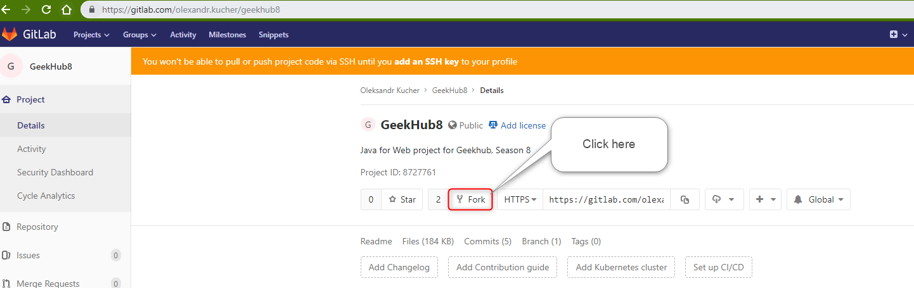
Fork GeekHub8 repository
Login to https://gitlab.com
Go to https://gitlab.com/olexandr.kucher/geekhub8
Click “Fork “ button
Select your user as namespace to fork the project

Slide 4
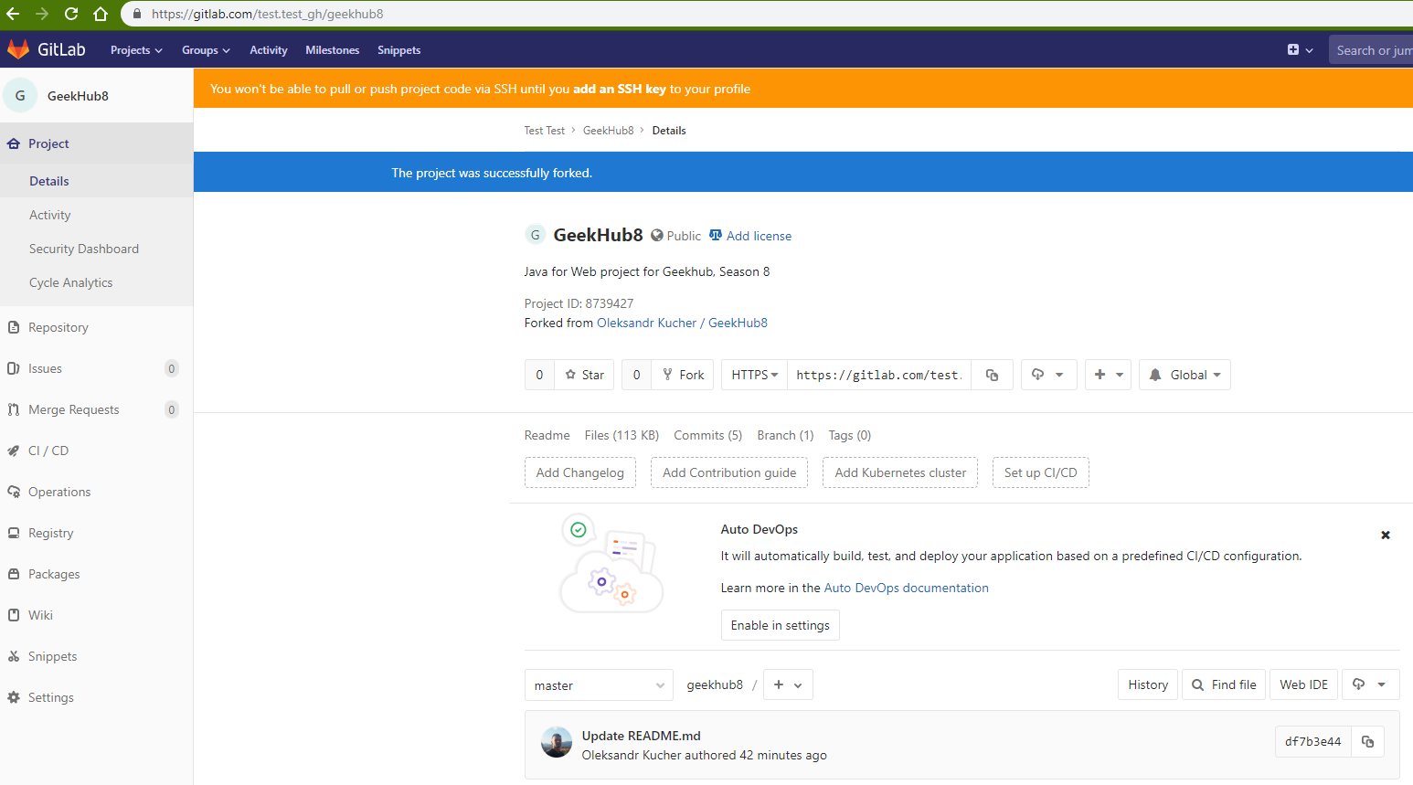
Fork GeekHub8 repository

Slide 5
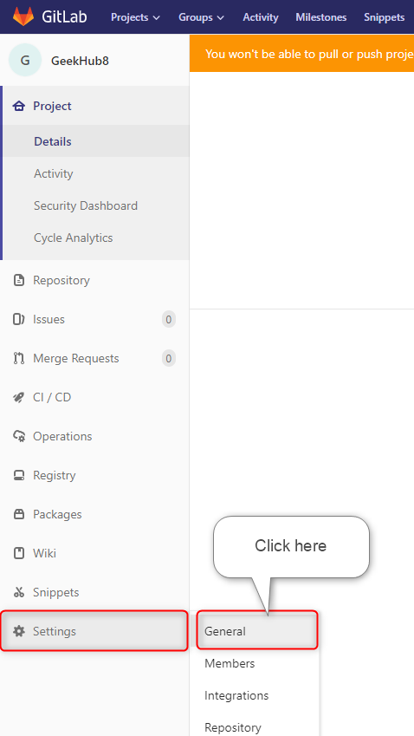
Fork GeekHub8 repository
Click “Setting” -> “General” on the opened page in sidebar menu

Slide 6
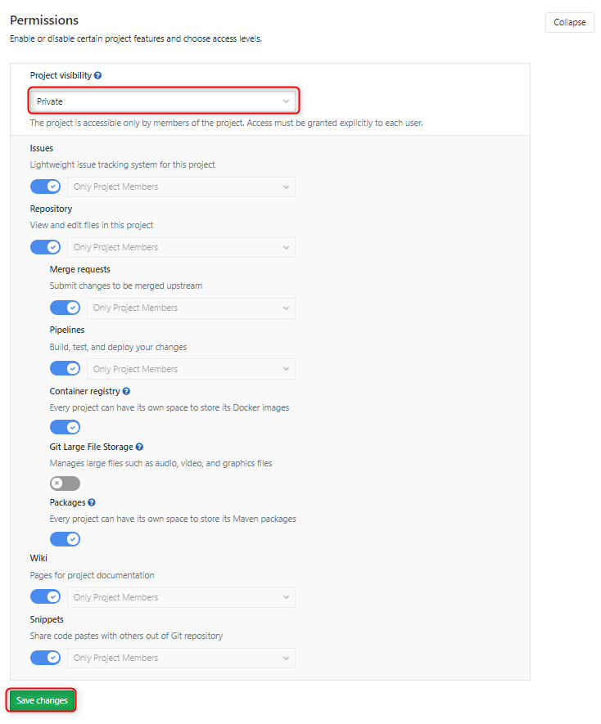
Fork GeekHub8 repository
Expand “Permissions” section
Change “Project visibility” to “Private”
Click “Save changes” button

Slide 7
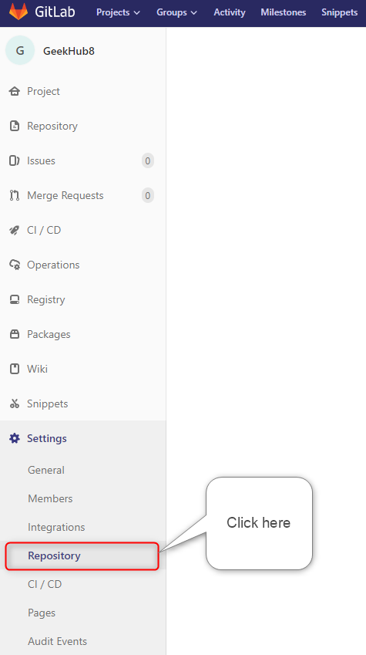
Fork GeekHub8 repository
Click “Setting” -> “Repository” in sidebar menu

Slide 8
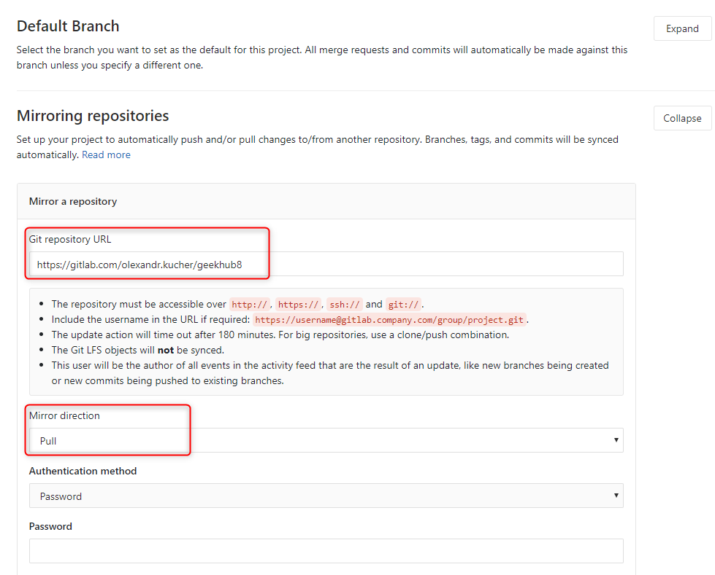
Fork GeekHub8 repository
Expand “Mirroring repositories” section
Paste or type https://gitlab.com/olexandr.kucher/geekhub8 into “Git repository URL” field
Choose “Pull” as “Mirror direction”

Slide 9
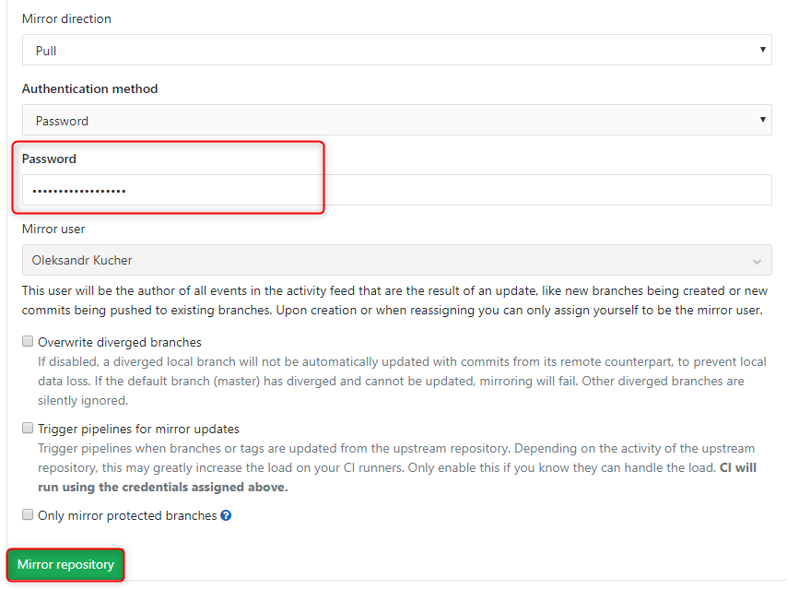
Fork GeekHub8 repository
Type your password to approve the action
Click “Save changes” button

Slide 10
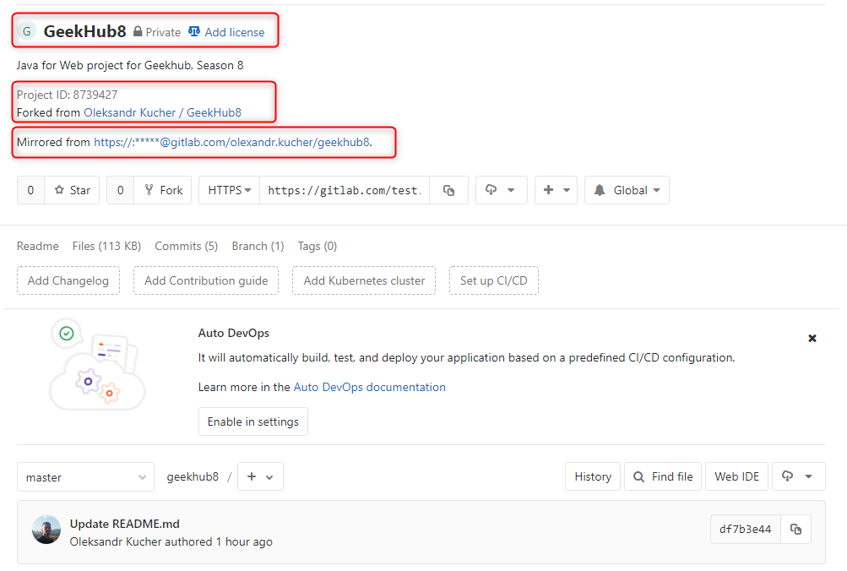
Fork GeekHub8 repository
Click “Project” -> “Details” in sidebar menu
Verify that all options in your repository are the same as on the screenshot

Slide 11
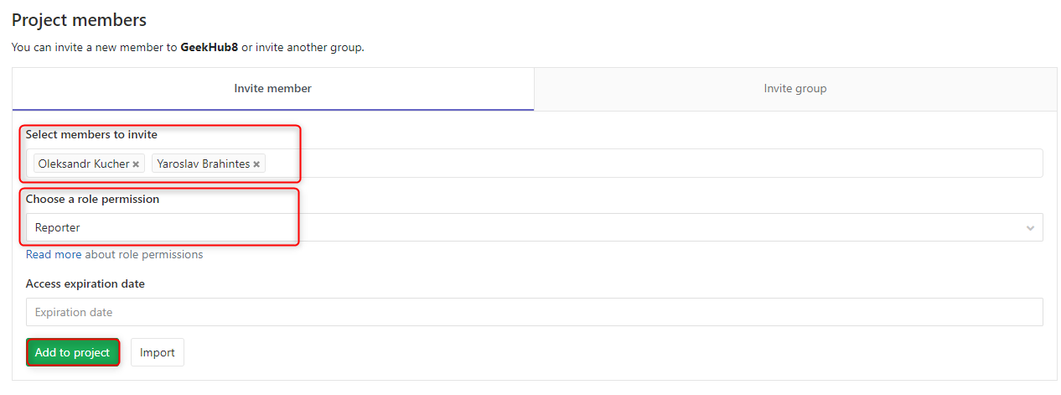
Fork GeekHub8 repository
Click “Settings” -> “Members” in sidebar menu
Choose olexandr.kucher and y.brahinets as Reporter
Click “Add to project”

Slide 12
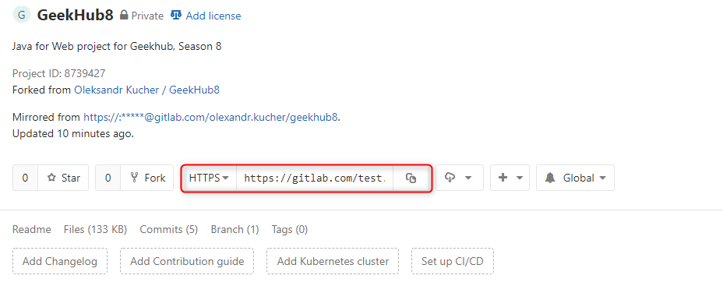
Import project into IDEA
Click “Project” -> “Details” in sidebar menu
Choose HTTPS type of link
Copy link to your repository

Slide 13
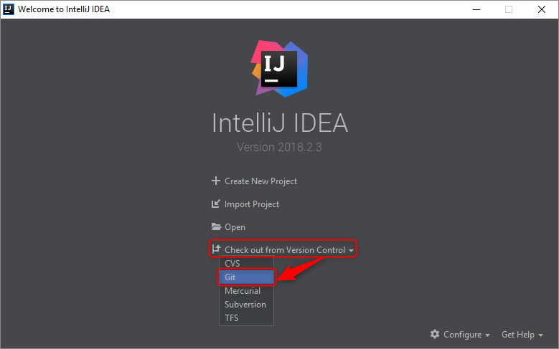
Import project into IDEA
Open Intellij IDEA
Choose “Check out from Version Control”
Choose “Git”

Slide 14
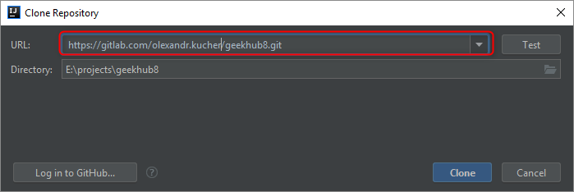
Import project into IDEA
Paste copied link of repository into just opened window
Click “Clone”

Slide 15
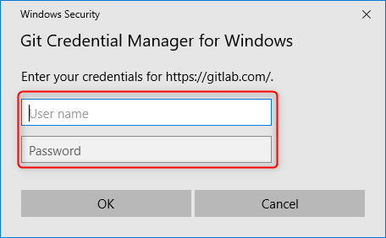
Import project into IDEA
Input your login and password for Gitlab.com if required

Slide 16
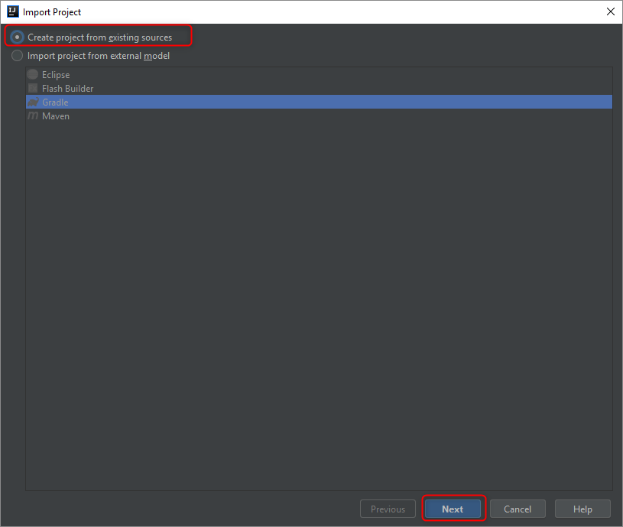
Import project into IDEA
Choose “Create project from existing source”
Click “Next”

Slide 17
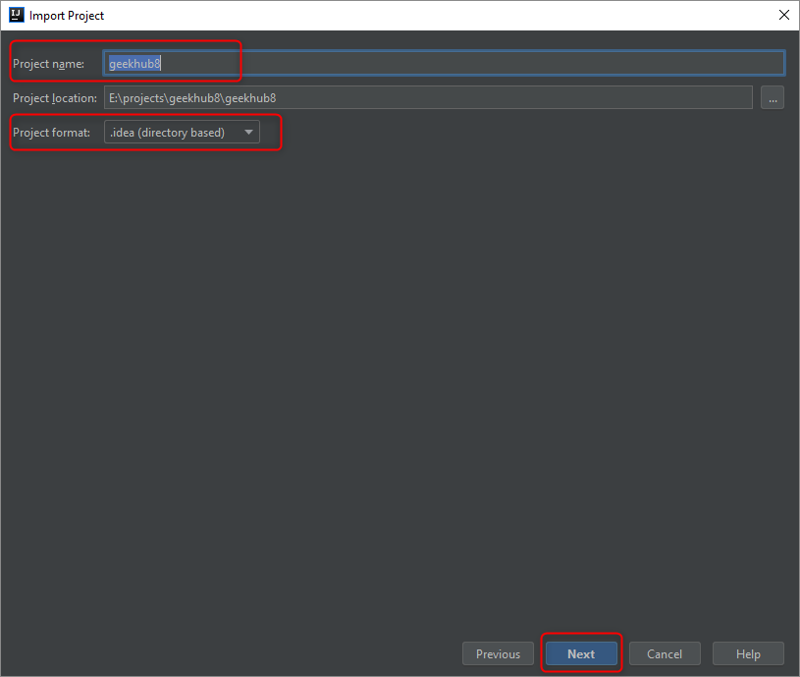
Import project into IDEA
Do not change “Project name”
Use default “Project format”: .idea
Click “Next”
Click “Next”
Click “Finish”

Slide 18
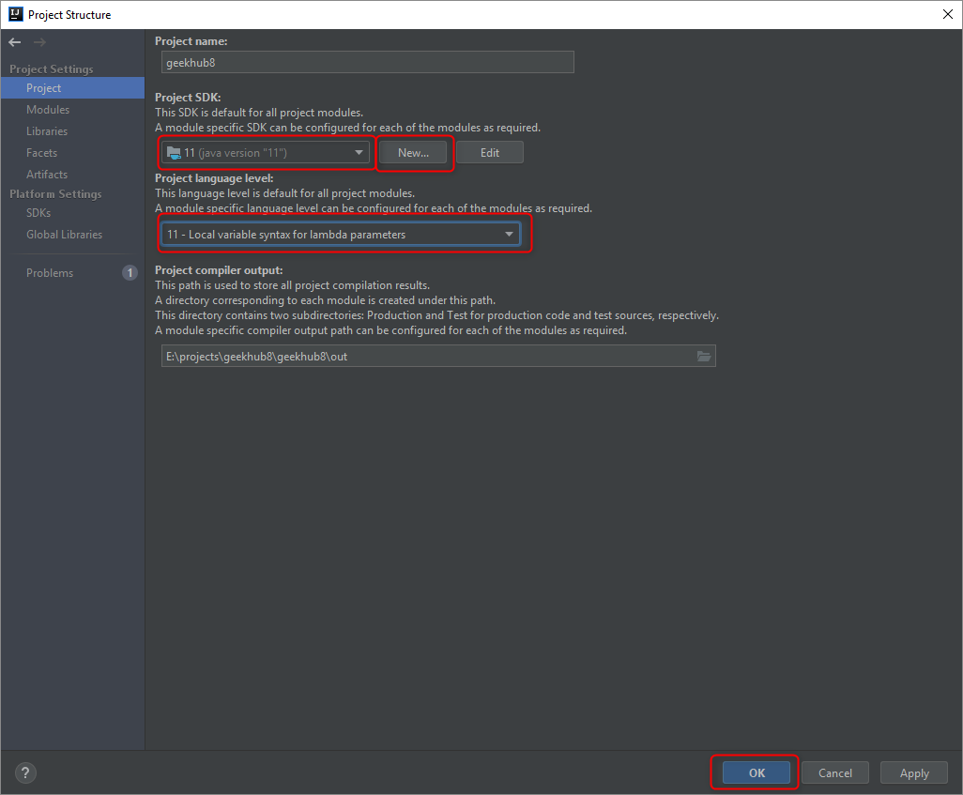
Import project into IDEA
Choose your project and press “Ctrl+Enter”
Choose “Project” tab
Add new JDK for IDEA by clicking “New” button, if required
Choose JDK 11 for your project
Choose “Project language level”: 11 – Local variable…
Click “OK”

Slide 19
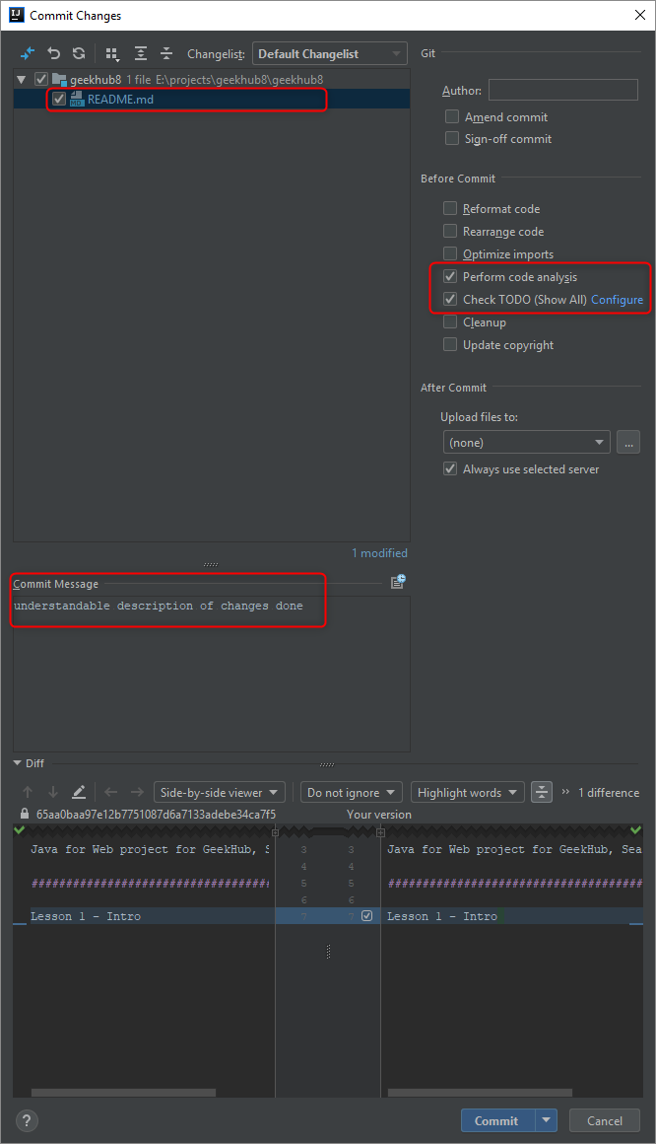
First Commit and Push to Git
You have made some changes, it’s time to commit and push
Press “Ctrl+K” to make commit
Choose files that should be committed
Type understandable and informative “Commit Message”
Check checkboxes: “Perform code analysis” and “Check TODO”
Click “Commit”

Slide 20
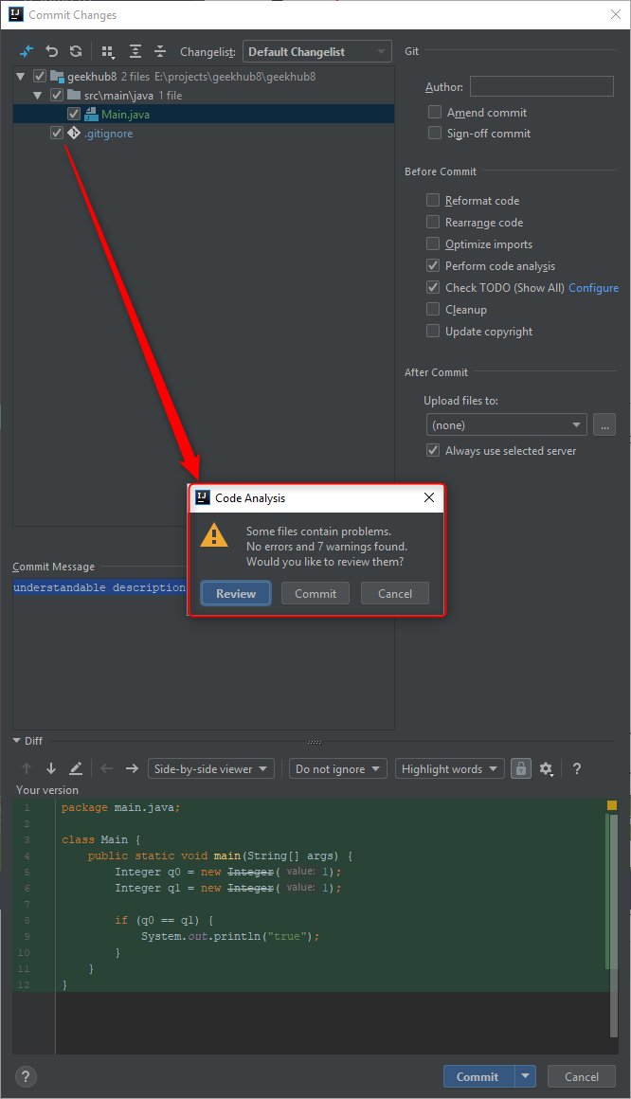
First Commit and Push to Git
Do not commit anything if you got some error or warning message

Slide 21
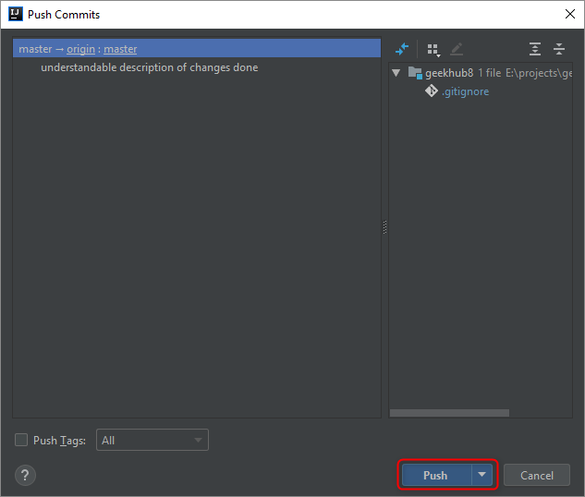
First Commit and Push to Git
Press “Ctrl+Shift+K” to push changes to remote repository
Click “Push”

Slide 22
Literature
https://git-scm.com/book/en/v2
https://try.github.io
https://gitlab.com/help
https://about.gitlab.com/2016/12/01/how-to-keep-your-fork-up-to-date-with-its-origin

